Slide 1
ABOUT SUMER- ONLINE MENTOR, LIFE TIME LEARNER,TIRELESS SOUL
SHARING AND CARING (SPIRITUALITY)
STOP HATING ,START LOVING
ENTHUSIASM TO WORK ,AND ENTHUSIASM TO BE COMPASSIONATE
DO WHAT YOU LOVE TO DO?
NEVER UNDERESTIMATE YOURSELF
YOU ARE STRONGER THAN YOU THINK

Slide 2
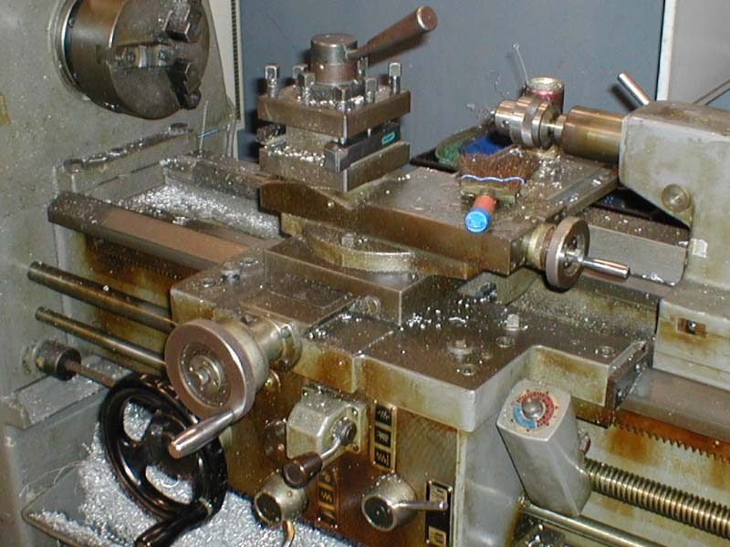
Workshop Technology
Lathe Machine
Presented By – SUMER SINGH RAO

Slide 3
MACHINE TOOLS
INTRODUCTION:
The process of metal cutting in which chip is formed is effected by a relative moment b/w the work piece and the edge of the cutting tool. The relative motion is produced by a combination of rotary and translatory moments of either work piece (or) tool (or) both.
Eg:
Machine Tool | Relative Motion
 | Work | Tool
Lathe | R | T
Shaper, Planer | T | T
Drilling | Fixed | R & T
Milling | T | R
Surface Grinding | T | R
Cylindrical Grinding | R & T | R
2

Slide 4
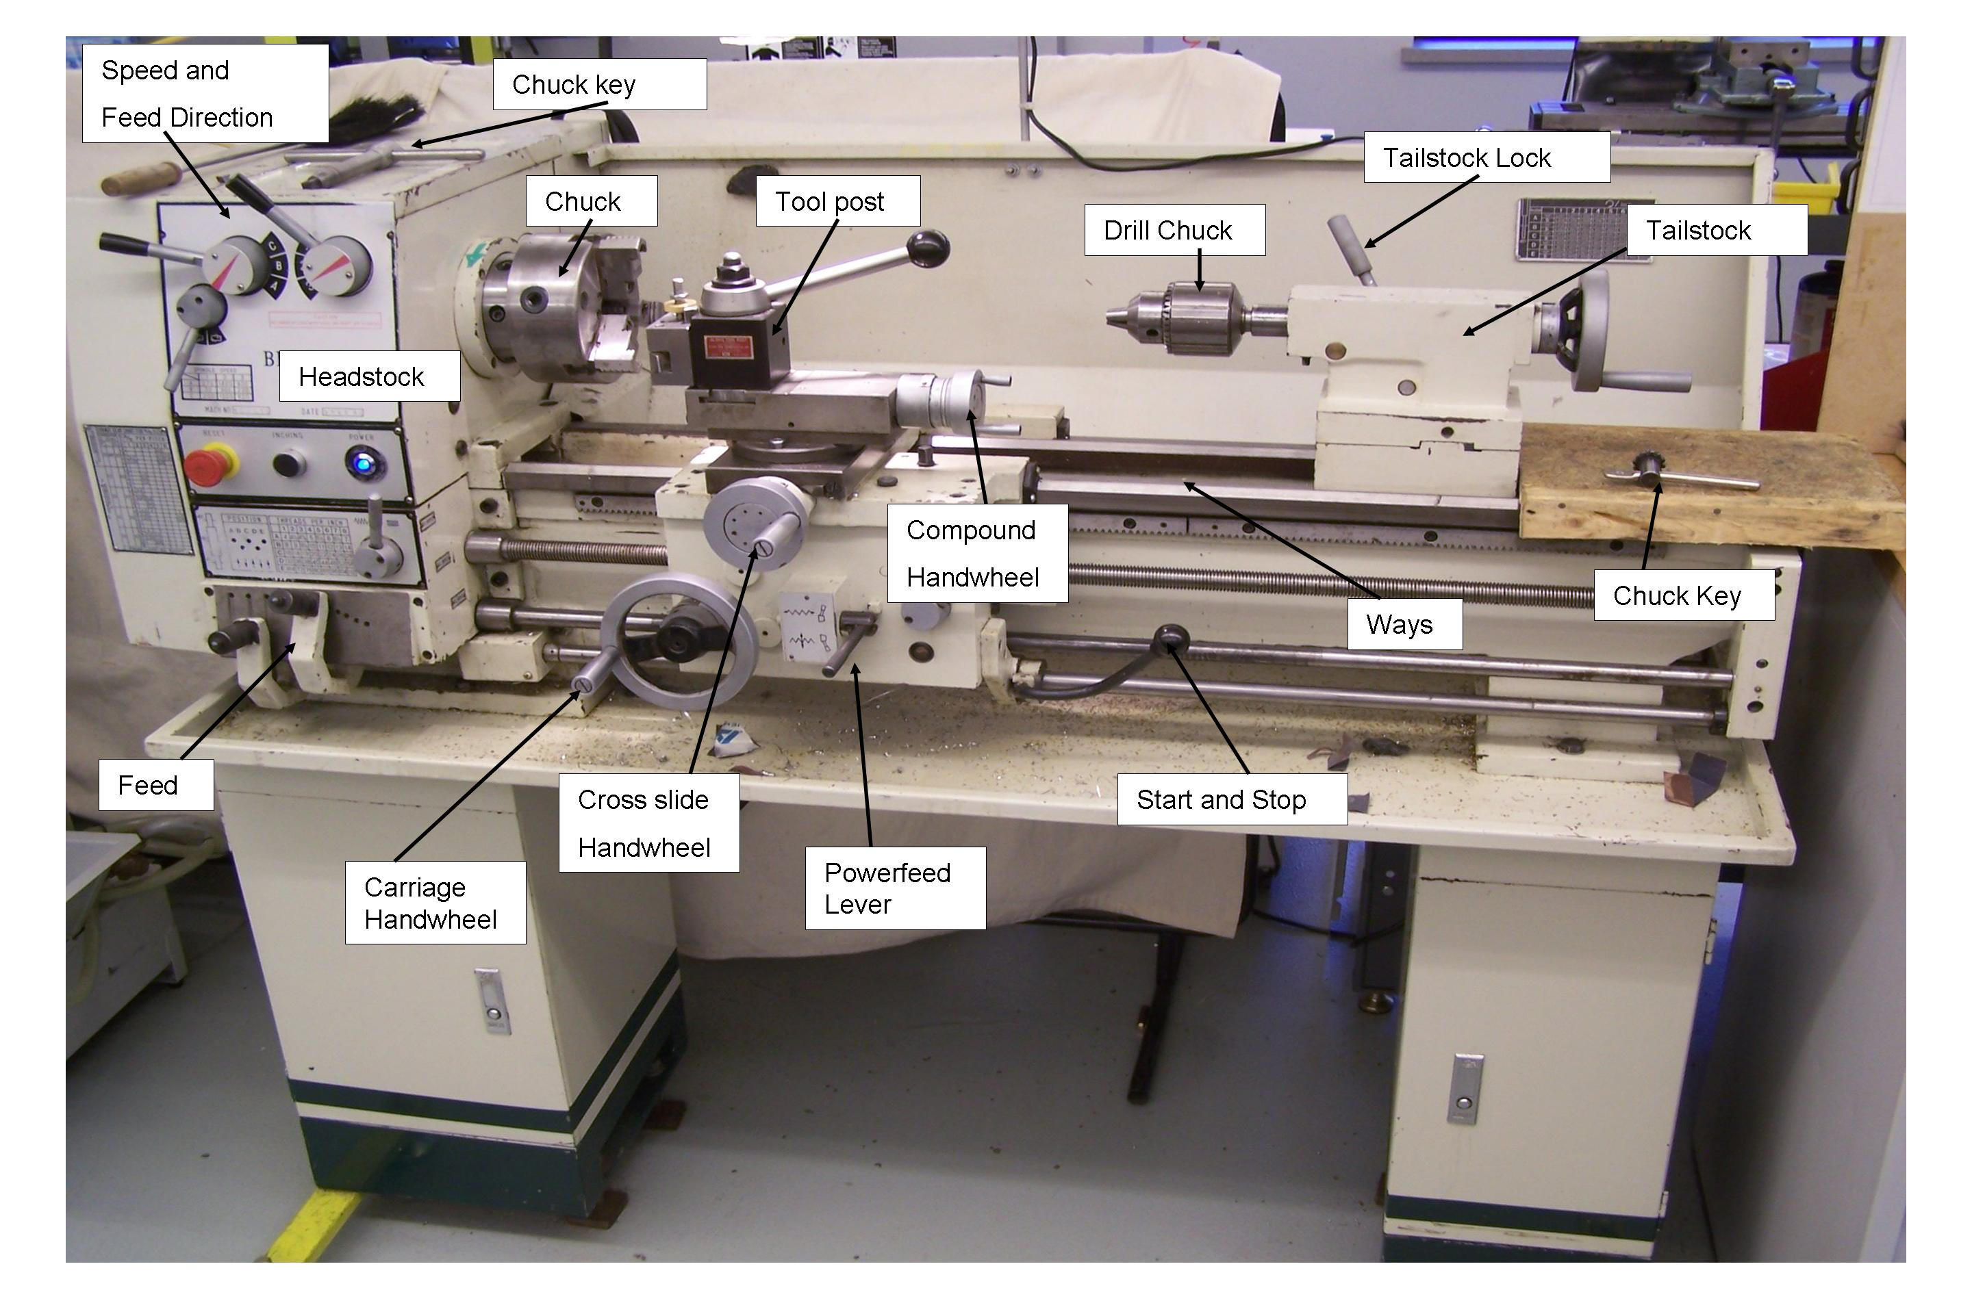

Slide 5
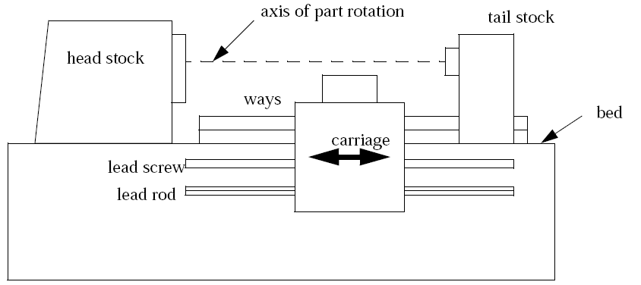

Slide 6
Lathe
A lathe is a large machine that rotates the work, and cutting is done with a non-rotating cutting tool. The shapes cut are generally round, or helical. The tool is typically moved parallel to the axis of rotation during cutting.
head stock - this end of the lathe contains the driving motor and gears. Power to rotate the part is delivered from here. This typically has levers that let the speeds and feeds be set.
ways - these are rails that the carriage rides on.
tail stock - this can be used to hold the other end of the part.

Slide 7
Lathe
Bed - this is a bottom pan on the lathe that catches chips, cutting fluids, etc.
carriage - this part of the lathe carries the cutting tool and moves based on the rotation of the lead screw or rod.
Lead screw - A large screw with a few threads per inch used for cutting threads. It has ACME threads with included angle of 29º for easy engagement and disengagement of half nut.
Lead rod - a rod with a shaft down the side used for driving normal cutting feeds.

Slide 8
LATHE – MAIN PARTS
Email:
3

Slide 9
CARRIAGE ASSEMBLY
SLIDE
SLIDE
4

Slide 10
TYPES OF LATHES
1) Bench lathe: It is a very small lathe mounted on separately prepared bench or cabinet and used for small, precision works.
10

Slide 11
feed
2) Speed lathe: They do not have provision for power and have no gear box, carriage, lead screw etc.
Two or three spindle speeds are available by cone pulley arrangement. They are used for wood turning, polishing, metal spinning etc
11

Slide 12
3) Engine lathe: In olden days lathe was driven by a
steam
engine. Hence the name is still in existence even after modern lathes are provided with motor drive.
12

Slide 13
4) Tool Room Lathe: It is nothing
but the engine lathe
equipped with some extra attachments
for accurate and
precision work like taper turning attachment,
follower
rest, collets, chucks etc. The bed is relatively small.
13

Slide 14
5) Capstan & Turret lathes: These are semi automatic type
machines very useful for mass production (small lot sizes). Less skill is required for operator and wide range of operations can be performed. They carry special mechanisms for indexing their tool heads. They are provided with a front tool post which can hold 4 turning related tools and rear tool post which can hold 2 to 4 turning related tools. The turrets can hold only drilling related tools. The turning tools used in the rear tool post are reverse tools with reverse geometry.
14

Slide 15
Turret Lathe
15

Slide 16
Turret Lathe Layout
16

Slide 17
Capstan Lathe
17

Slide 18
Capstan Lathe Layout
18

Slide 19
 | Turret Lathe |  | Capstan lathe
1. | Turret head (square (or) hexagonal) is mounted on saddle | 1. | Turret head (round (or) square (or) hexagonal) is mounted on auxiliary slide that moves on guide ways provided on saddle
2. | The above arrangement gives rigidity as forces are transferred to bed. Hence capable of handling heavy jobs (up to 200mm) and severe cutting conditions. | 2. | Less rigidity, vibrations occur, hence suitable for lighter and smaller jobs (up to 60mm) and precision work.
3 | Tool travel is along entire bed length | 3. | Tool travel is limited because of auxiliary slide traverse limitation.
4. | Tool feeding is slow and causes fatigue to operator hands | 4. | Tool feeding is fast and causes less fatigue to operator hands.
5. | No tail stock | 5. | No tail stock
19

Slide 20
6) Automatic lathes: These are designed so that all the working and Job handling movements of the complete Manufacturing process for a job are done automatically. No participation of the operator is required during the operation. They fall in the category of heavy duty, high speed lathes employed in mass production(large lot sizes) of high quality fasteners; bolts, screws, studs.
20

Slide 21
WORK HOLDING DEVICES
Chucks ----
3 Jaw – Self centering, smaller in size, used for round cross sections
4 jaw – Not self centering, medium in size, used for round, square, rectangular cross sections.
21

Slide 22
c) Collets– Fixed size. They are air operated or hand operated. Used in – Tool Room lathes, Bar Automatic Lathes,
Vertical Milling m/c to hold end mills.
22

Slide 23
2) Face plate
– Used for large size work pieces
of round, square, rectangular, and also very complex geometries not possible in any other devices.
23

Slide 24
Carriers and catch plates – Used for supporting shafts, mandrels for imparting rotation.
Centers – For supporting
Live centre – used with
face plate
Dead centre – used in
tail stock
24

Slide 25
5) Mandrel – Used to support the work pieces and also for holding hollow parts to meet concentricity requirements
Live Work piece
Centre
Dead Centre
Face Plate
Mandrel
Carrier Dog
25

Slide 26
6) Steady rest – mounted on bed, used for long heavy jobs that deflect centrally by self weight
7) Follower rest – mounted on carriage and moves with tool, used for long thin jobs that deflect laterally by cutting force.
26

Slide 27
TOOL POST
27

Slide 28
TOOL HOLDERS
HSS Tool Holders
28

Slide 29
Brazed Carbide tip Tool Holders (Can be grinded)
29

Slide 30
OPERATIONS
Straight turning: Here the work rotating about lathe axis, tool is fed parallel to it, depth of cut is perpendicular to it, thus producing a straight cylindrical surface. Here Diameter is effected but Length is not effected.
Shoulder / Step turning:
Same as above except that diameter is reduced only up to certain length.
d
30

Slide 31
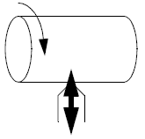
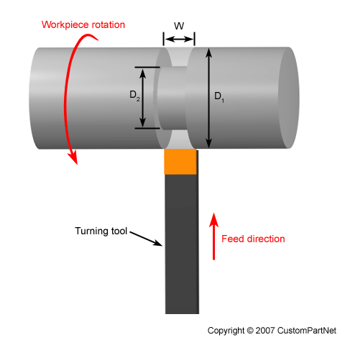
Parting/Slotting/Grooving
A tool is moved in/out of the work. shallow cut will leave a formed cut, a deep cut will cut off the unsupported part.

Slide 32
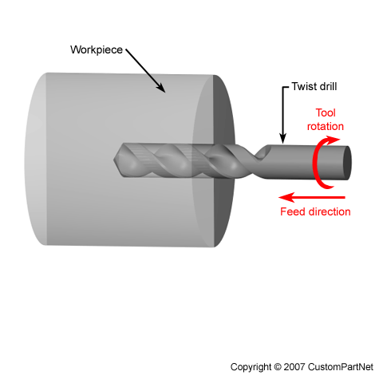
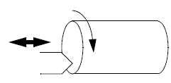
Drilling/Boring
Drilling/Boring - a cutter or drill bit is pushed into the end to create an internal feature.

Slide 33
3) Facing:- Here the tool is fed perpendicular to the lathe axis and depth of cut is parallel to
the lathe axis and thus producing a flat surface. Here Length (in Shafts) / thickness (in plates) is effected, but Diameter is not effected.
4) Knurling:- embossing a
Process of
diamond
shaped pattern on work surface which is used for gripping purpose.
33

Slide 34
5) Taper turning:- Operation of producing tapered surfaces. The following methods are used
Swiveling of compound rest –
Any Angle, Any Corresponding Taper length.
D₁
D₂
L
θ
D₁ = Larger Dia D₂ = Smaller Dia L = Taper length
θ = Half Cone Angle 2θ= Included Angle
34

Slide 35
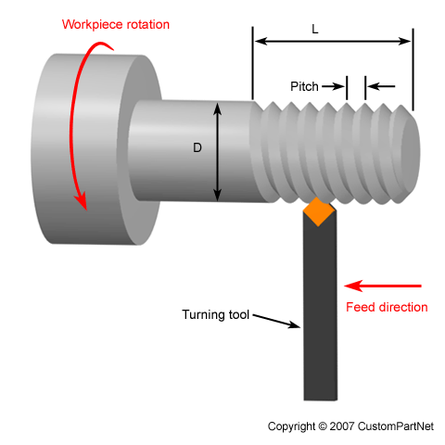
6) Thread cutting:- There are different thread forms like V, Square, etc. Here the tool has the shape of thread profile. Zero rake angle is used for form tools like threading tool, parting tool, grooving tool etc. In one revolution of the spindle, carriage must travel the pitch of the screw thread to be cut.
35

Slide 36
SHAPER MACHINE

Slide 37
37

Slide 38
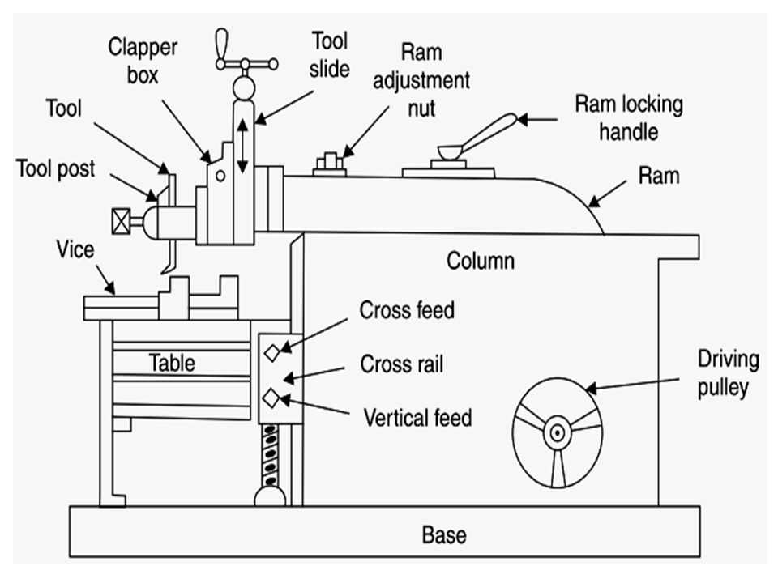

Slide 39
SHAPER MACHINE
The job is rigidly fixed on the machine table. The single point cutting tool held properly in the tool post is mounted on a reciprocating ram. The reciprocating motion of the ram is obtained by a quick return motion mechanism. As the ram reciprocates, the tool cuts the material during its forward stroke. During return, there is no cutting action
The cutting tool is a single point tool similar to lathe.
The shaper is a machine tool used primarily for:
1. Producing a flat or plane surface which may be in a horizontal, a vertical or an angular plane.
2. Making slots, grooves and keyways
39

Slide 40
1 Base
The base is the necessary bed or support required for all machines tools.
The base is hollow casting made of cast iron to resist vibration and on which all parts of the shaper are mounted.
2 Column
This is made of cast iron, which is a box-like and is mounted on the base.
3 Cross-rail
Cross rail is mounted on the front vertical surface of the column on which saddle is mounted.

Slide 41
4 Ram
The ram reciprocates on the column guideways and carries tool head with a single point cutting tool.
5 Table
The table is bolted to the saddle and receives crosswise and vertical movements from saddle cross rail.
T-bolts are used for clamping on top and sides.

Slide 42
TYPES
According to the type of mechanisms used for giving reciprocating motion to the ram.
Crank Shaper: Crank and Slotted lever mechanism is used to change rotary motion of the driving gear to
reciprocating motion to the ram.
42

Slide 43
43

Slide 44
b) Geared Shaper: Rack and pinion mechanism is used.
Geared shapers have a reversible electric motor or mechanical mechanism which quickly returns the ram, in readiness for another cut.
44

Slide 45
c) Hydraulic Shaper: By hydraulic power i.e. oil with high pressure is pumped into a cylinder with piston.
45

Slide 46
2. According to the position and travel of ram.
Horizontal shaper: Reciprocates in a horizontal axis.
Vertical shaper: Reciprocates in a vertical axis.
It has a round table that can rotate and also can be fed longitudinally and cross wise. Also the ram can be reciprocated at an angle up to
10⁰ from the vertical
position inclined
enabling machining surfaces.
46

Slide 47
3. According
to the type of design of the table:
Standard Shaper: Table has only 2 movements, feed.
Universal shaper:
to give
In addition to the 2 movements, the table can be swiveled about
a horizontal
axis
the ram the upper the table
parallel to ways and
portion of
can be tilted about a horizontal axis
47

Slide 48
OPERATIONS
OPERATIONS ON HORIZONTAL SHAPERS:
Machining Horizontal, Vertical, Angular surfaces
Cutting Slots, Grooves, Key ways, External Gears etc
48

Slide 49
49

Slide 50
DRILLING MACHINE
INTRODUCTION: A
drilling machine
was hole,
primarily designed to originate
a
but it can also
perform a No. of
similar machine
operations. In
a drilling
holes may be drilled quickly
and at low cost. The hole is generated by the rotating edge of a cutting tool known as the drill which exerts large force on the work clamped on the table. The cutting motion is provided by rotating the drill and feeding is done by giving rectilinear motion to the drill in
the axial direction. Here the drill used has two cutting edges called lips.
50

Slide 51
TYPES
(1) Portable drilling machine:
This type of D.M. can be operated with ease anywhere in the work shop and is used for drilling holes in work pieces in any position which cannot be drilled in a standard D.M. The entire D.M. including the motor is compact and small in size. The max. size of the drill that can accommodate is not more than 12 to 18 mm.
51

Slide 52
2) Round Column Section (or) Pillar D.M.: It consists of round column and a round table. The table can be moved up and down on the column for
accommodating heights. The
W.P. of different table may be rotated
360º about its own centre. The max. size of the hole that can be drilled is
not more than 50mm.

Slide 53
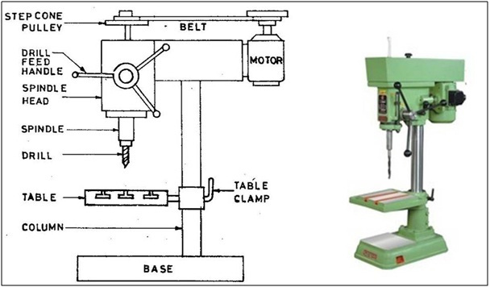

Slide 54
(3) Radial D.M: It is
intended
for drilling medium to
large and heavy W.P. It consists of
a heavy,
round
vertical column mounted on a large base. The column supports a radial arm which can be raised and lowered to accommodate work pieces of difference heights The arm may be swung around to any position over the work bed. The drill head containing mechanism for rotating and feeding the drill is mounted on the radial arm and can be moved horizontally on the guide ways and clamped at any desired position.

Slide 55
RDM.:- It has the movements explained above.

Slide 56
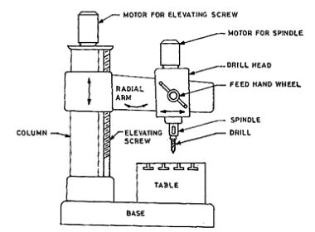

Slide 57
(4) Gang D.M.: When a No. of
single spindle D.M. columns are placed side by side on a
common common,
base and work
have a
table,
the
machine is known as
G.D.M.
In a G.D.M. 4 to 6 spindles
may be mounted side by side. The speed and feed of spindles are controlled independently.
104

Slide 58
TERMINOLOGY
Drills are manufactured as:
Tang
Shank
1. Straight
shank drills (up to ϕ
13.5 mm)
Neck
2. Taper shank Drills (ϕ
14.0 mm onwards)
Body
Tip
58

Slide 59
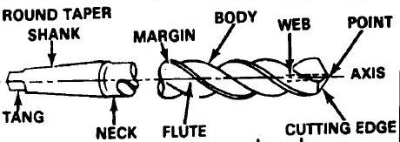
TWIST DRILL

Slide 60
DRILL GEOMETRY
Lip angle/ Tip Angle/ Point Angle
60

Slide 61
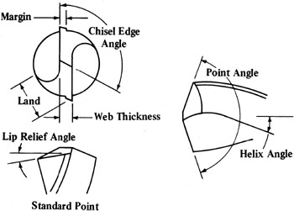
Drill
The twist drill does most of the cutting with the tip of the bit.
There are flutes to carry the chips up from the cutting edges to the top of the hole where they are cast off.

Slide 62
Land / Margin: It maintains the alignment of the drill so that hole is straight and to the right size.
Helix angle: Angle formed b/w a plane containing drill axis and the leading edge of land. Based on the value of the angle the drills can be classified
Lip angle: Angle formed b/w the cutting edges
Clearance / Lip relief Angle: Angle formed b/w flank and a plane normal to drill axis at the tip of the drill.
62

Slide 64
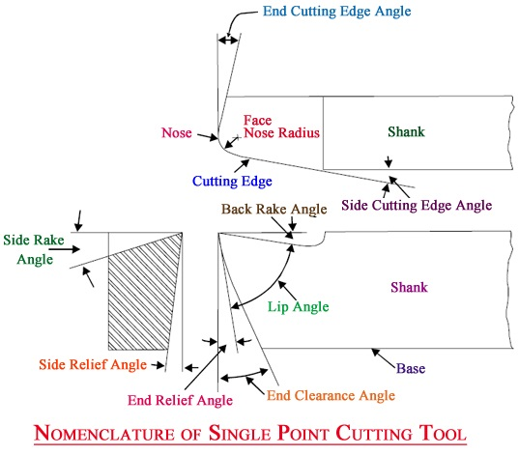

Slide 65
OPERATIONS
Drilling – Process of making hole in solid body.
Boring – Enlarging a hole completely with an adjustable tool with only one cutting edge.
Counter boring - Enlarging one end of the hole to form a square shoulder with original hole to avoid projections
in assemblies.
Counter sinking - Making a cone shaped enlargement to provide a recess for a screw head.

Slide 66
Reaming – Sizing and finishing a small unhardened hole.

Slide 67
6)Tapping–Process of making internal threads in small holes.
Machine Tap with holder
Manual Tap

Slide 68
IMPORTANT QUESTIONS(UNIT 2 & 3)
Q1.EXPLAIN THE CONSTRUCTIONAL DETAILS OF CENTRE LATHE MACHINE.
Q2.EXPLAIN DIFFERENT LATHE MACHINE OPERATIONS.
Q3.EXPLAIN DIFFERENT CUTTING TOOLS USED ON LATHE MACHINE.
Q4.WRITE DIFFERENCE BETWEEN CAPSTAN AND TURRET LATHE.
Q5.EXPLAIN TAPER TURNING METHOD ON LATHE MACHINE.
Q6.EXPLAIN CONSTRUCTIONAL DETAILS OF SHAPER MACHINE.
Q7.EXPLAIN DIFFERENT TYPES OF SHAPER MACHINE.
Q8.EXPLAIN CRANK AND SLOTTED LEVER MECHANISM.
Q9.EXPLAIN DIFFERENT OPERATIONS PERFORMED ON SHAPER MACHINE.
Q10. EXPLAIN RADIAL AND PILLAR TYPE DRILLING MACHINE.
Q11.EXPLAIN DIFFERENT DRILLING OPERATIONS.
Q12.EXPLAIN GEOMETRY OF TWIST DRILL.
Q13.EXPLAIN DIFFERENCE B/W HOT AND COLD WORKING PROCESS
Q14.EXPLAIN FOLLOWING PROCESS- 1.ROLLING 2.FORGING 3.EXTRUSION 4. WIRE DRAWING 5.SHEET METAL PROCESS

Slide 69
IMPORTANT QUESTIONS(UNIT 1&4)
Q1.EXPLAIN FOLLOWING:- 1.TYPES OF PATTERN 2.TOOLS AND EQUIPMENT UESD IN MOULDING 3.CORE &TYPES OF CORE
4.CASTING DEFECTS 5.SAND CASTING PROCESS WITH DIAGRAM
Q2.EXPLAIN TYPES OF MOULDING SAND AND ITS PROPERTIES
Q3.WHAT IS CASTING? EXPLAIN INVESTMENT CASTING
Q4.WHAT IS WELDING ? EXPLAIN ELECTRIC ARC WELDING
Q5.EXPLAIN FOLLOWING:-1.WELDIND &TYPES OF WELDING 2. WELDING TOOLS AND SAFETY DEVICES
3.TYPES OF WELD AND WELDING JOINT 4.SOLDERING AND BRAZING
5.WELDING DEFECTS 6.TYPES OF ELECTRODES
Q6.WHAT IS PRINCIPLE OF RESISTANCE WELDING?EXPLAIN BUTT WELDING WITH NEAT SKETCH.
Q7.WHAT IS PRINCIPLE OF OXYACETYLENE GAS WELDING ?EXPLAIN TYPES OF FLAMES
Q8.EXPLAIN TIG AND MIG WELDING.

