Slide 1
ABOUT SUMER- ONLINE MENTOR, LIFE TIME LEARNER,TIRELESS SOUL
SHARING AND CARING (SPIRITUALITY)
STOP HATING ,START LOVING
ENTHUSIASM TO WORK ,AND ENTHUSIASM TO BE COMPASSIONATE
DO WHAT YOU LOVE TO DO?
NEVER UNDERESTIMATE YOURSELF
YOU ARE STRONGER THAN YOU THINK

Slide 2
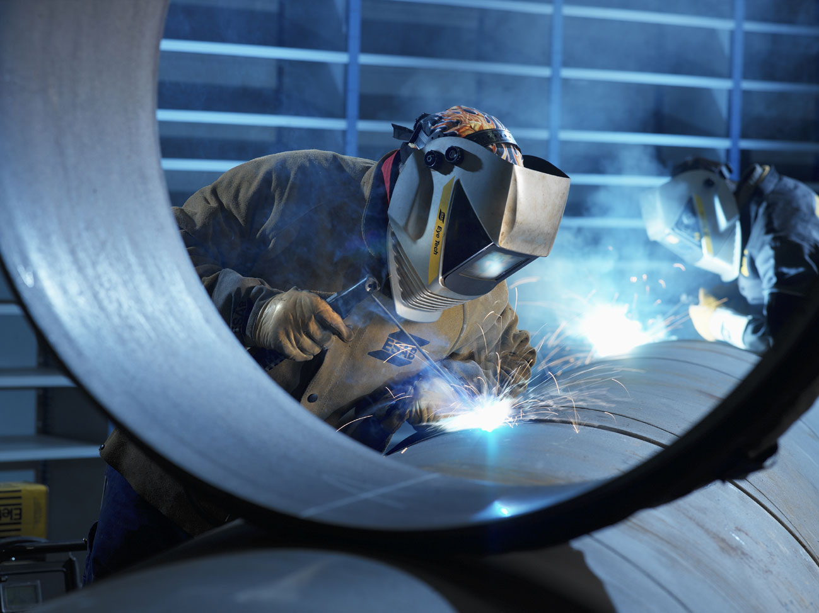
Workshop Technology
WELDING
Presented By – SUMER SINGH RAO

Slide 3
WELDING
CLASSIFCATION:
3

Slide 4
Welding: It is the process of joining similar dissimilar metals with / without application of heat, with / without application of pressure and with / without addition of filler material.
Weldability: It is the capacity of being welded into inseparable joints having specified properties such as definite weld strength, proper structure etc. Weldability depends on : (1) Melting point (2) Thermal conductivity (3) Thermal expansion (4) Surface condition (5) Change in Micro structure etc.
These characteristics may be controlled / corrected by
proper shielding atmosphere, proper fluxing material, proper filler material, proper welding procedure, proper heat treatment before and after deposition.
4

Slide 5
Types of Welds & Welded joints:
The different types of joints are Lap, Butt, Corner, etc. Butt Joints require edge preparation like V, U, J, Bevel.
V – Joints are easier to make but amount of metal to be filled increases with thickness. Hence other preparations are
preferred for higher thicknesses.
Double preparation is done for still higher thicknesses.
5

Slide 6
Gas Welding:
It is the process of generating the heat required for melting the joint by burning a combustible gas with air/oxygen in a concentrated flame at high temp. It can weld most common materials.

Slide 7
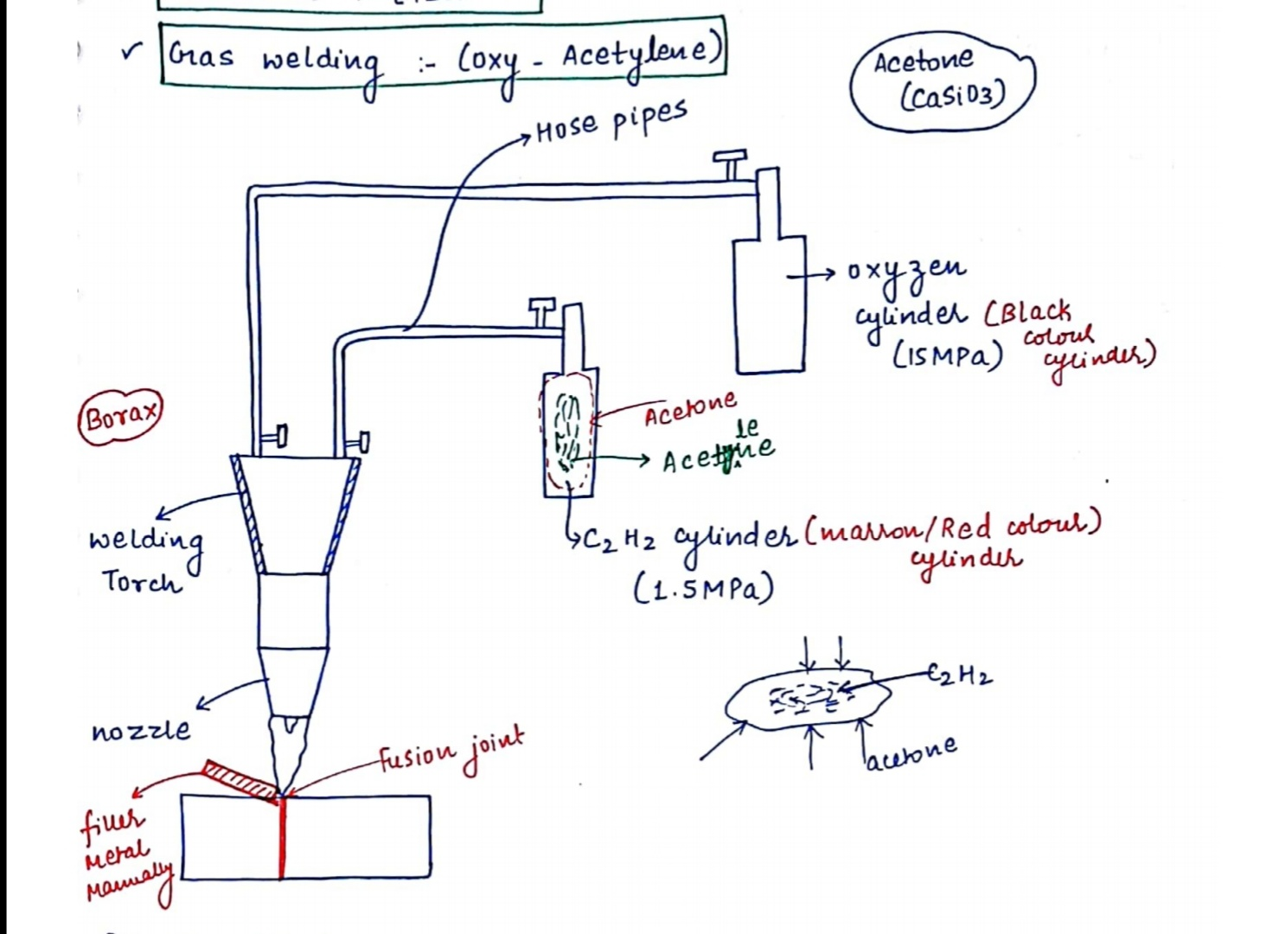

Slide 9
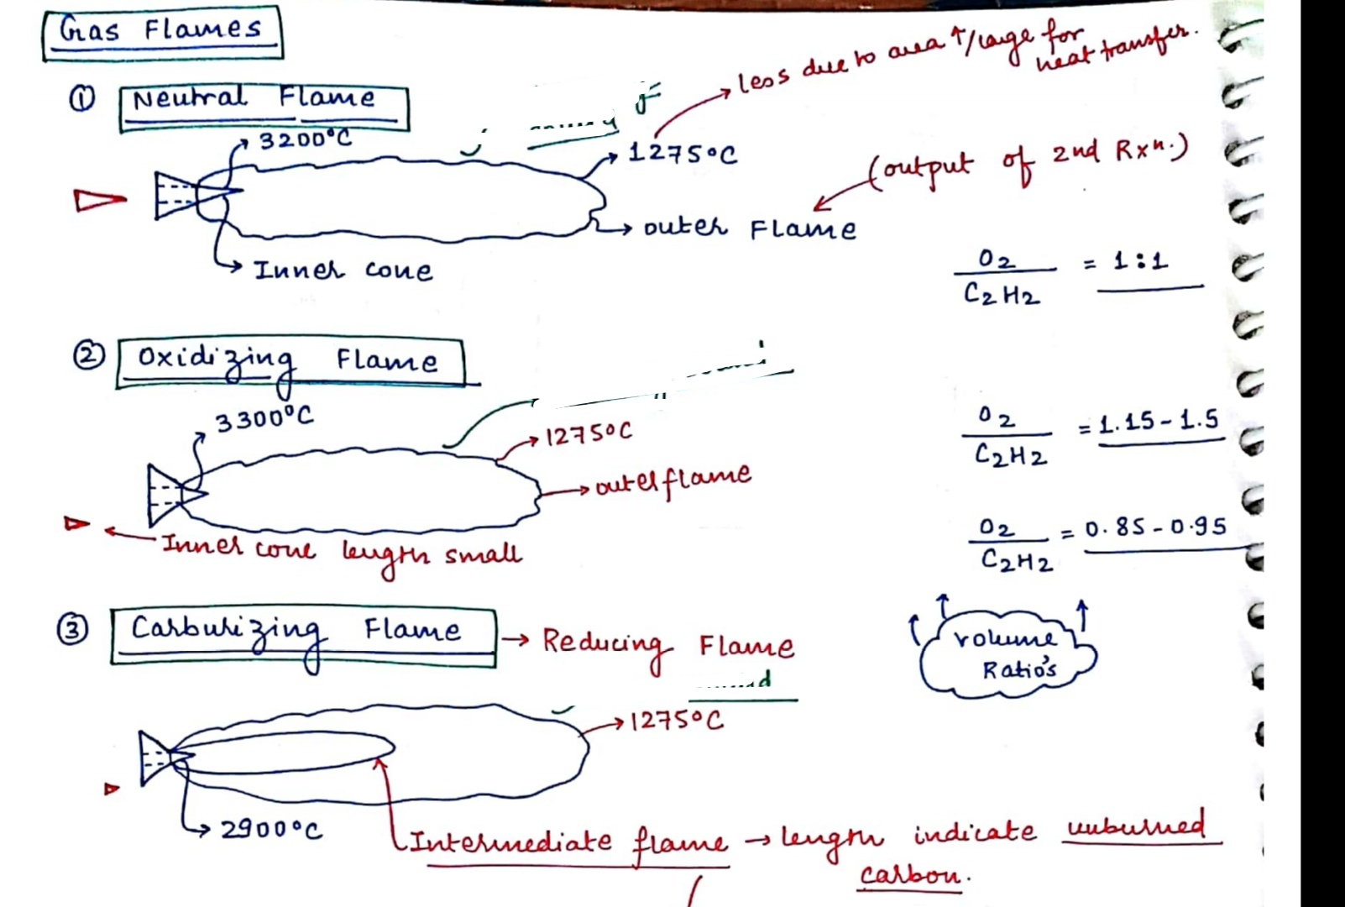

Slide 11
Chemistry of Oxy Acetylene Process
The most common fuel used in welding is acetylene. It has a two stage reaction;
The first stage primary reaction involves the acetylene disassociating in the presence of oxygen to
produce heat, carbon monoxide, and hydrogen gas. 2C₂H₂ + 2O₂ = 4CO + 2H₂ + Heat ---------- (1)
A secondary reaction follows where the carbon monoxide and hydrogen combine with more oxygen to
produce carbon dioxide and water vapour.
4CO + 2H₂ + 3O₂ = 4CO₂ + 2H₂O + Heat--------- (2)
When you combine equations (1) and (2) you will notice that about 5 parts of oxygen is necessary to consume 2 parts of acetylene
2C₂H₂ + 5O₂ = 4CO₂ + 2H₂O + Heat ----------- (3)

Slide 12
Hence it can be seen that 2.5 volumes of oxygen is required for consuming of 1 volume of acetylene. In the first reaction 35.6% of total heat is generated at the inner cone by burning one volume of Oxygen and one volume of acetylene supplied from the cylinders. The remaining 1.5 volumes of oxygen is supplied from
atmosphere. Types of Flames:
1. Neutral Flame: When oxygen and acetylene are supplied
in nearly equal volumes, this is produced temperature of 3200ºC.
having a max.

Slide 13
Carburizing Flame:
There is excess of acetylene. This has 3 zones, sharp inner cone, intermediate whitish cone, bluish outer cone. The length of the intermediate cone is an indication of the proportion of excess acetylene

Slide 14
Oxidizing Flame:
There is excess oxygen. It has inner cone with purplish tinge and outer cone. This is used for non-ferrous alloys.

Slide 15
Arc Welding:
It is a process of generating the heat required for melting the joint by means of an electric arc. This is most widely used than Gas welding because of the ease of use and high production rates.
Principle of Arc:
An Arc is generated between two conductors of Electricity, Cathode and Anode, when they are touched to establish the flow of current and then separated by a small distance. An arc is a sustained electric discharge through the ionized gas column called plasma between the two electrodes. The electrons liberated from the cathode strike the anode at high velocity, generating large amount of heat (6000ºC). About 65% to 75% of total heat is liberated at anode.

Slide 18
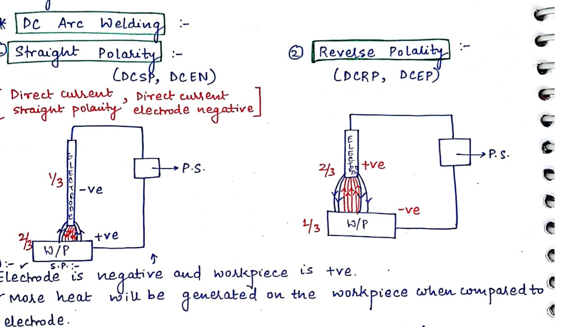

Slide 19
It should be noted that Arc temperature depends upon the energy density of the arc column.
With AC the cathode and anode change continuously and as
a result temp. across
the arc would be more uniform
compared to a DC arc.
Straight Polarity / DCEN (Direct Current Electrode – ve) is
used for thick sheets.
Here the W.P. is anode, thus more
heat is liberated at the anode which gives deeper penetration.
Reverse Polarity / DCEP (Direct current Electrode +ve) is used for thin sheets. Here penetration is small.
In AC welding, the penetration obtained is medium.
DC welding is more expensive and is used for difficult tasks.

Slide 21
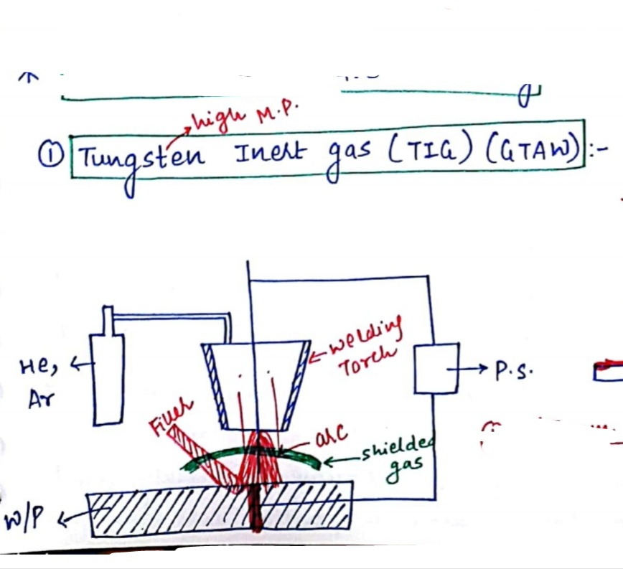

Slide 23
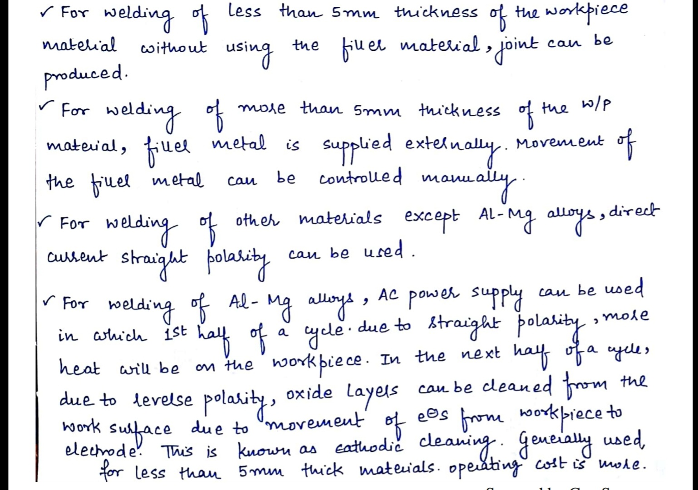

Slide 24
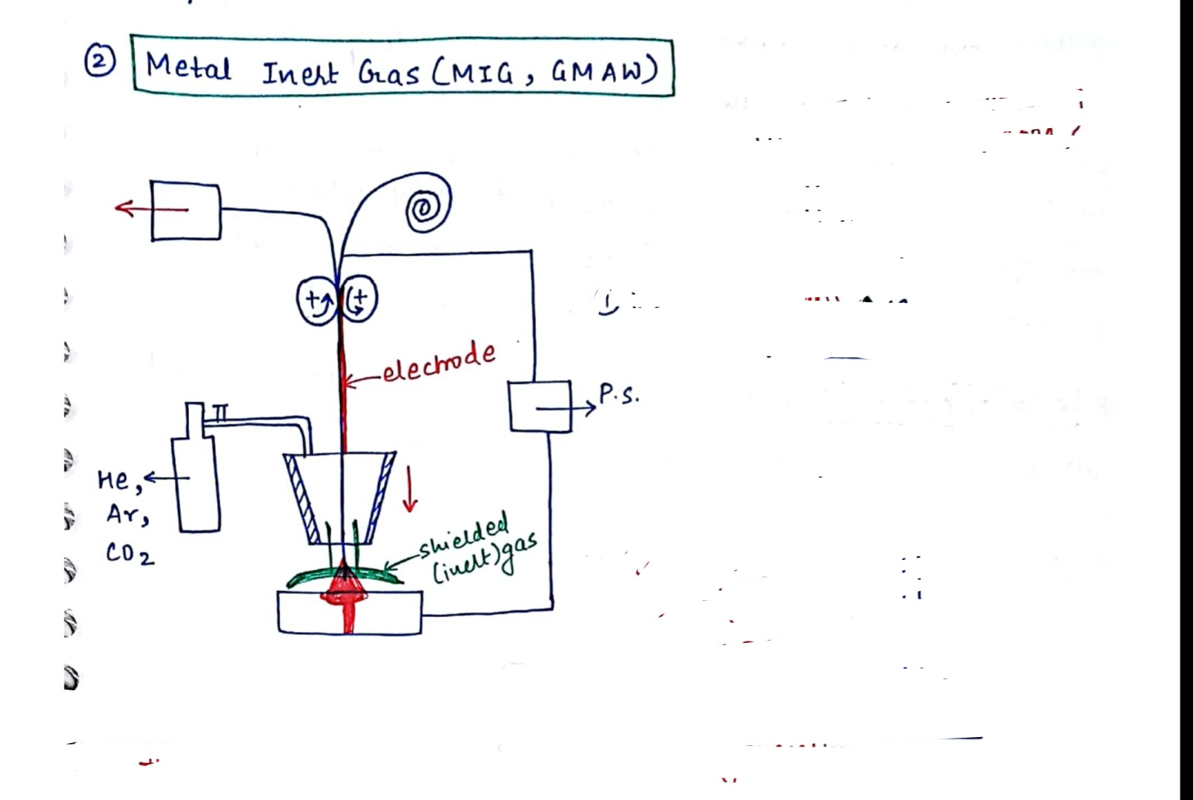

Slide 29
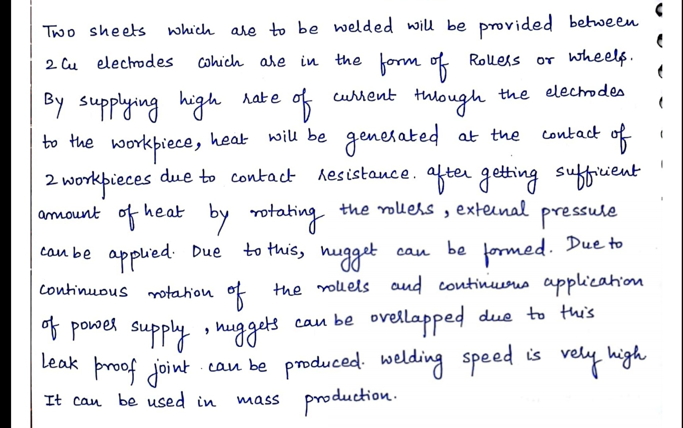

Slide 31
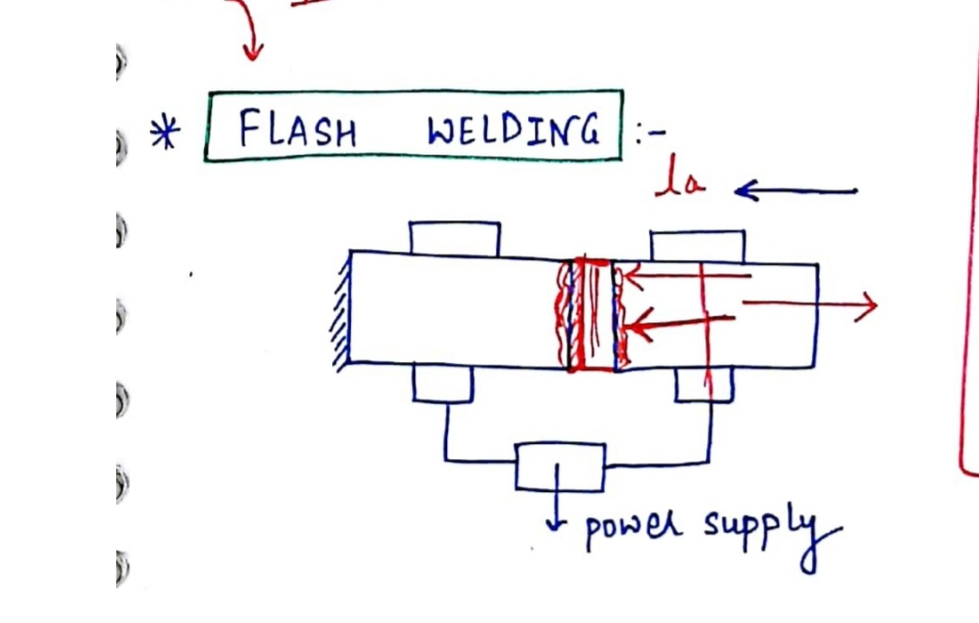

Slide 34
Electrodes:
The electrodes used can be consumable (same base material) (or) Non-consumable (Tungsten, Carbon or Graphite). The consumable electrode can be either coated (stick electrode) or uncoated (bare electrode). The coatings serve a No. of purposes.
To facilitate establishment and maintenance of arc
To produce shield gas around arc & weld pool
To provide formation of slag to reduce rapid cooling.
To introduce alloying elements not contained in core wire.

Slide 36
Gas Metal Arc Welding (GMAW) (or) Metal Inert Gas
(MIG) Welding:
This is a gas shielded, metal arc welding process, where, the consumable electrode wire is continuously fed from a reel and the welding area is flooded with a inert gas which will
not combine with metal. The wire is often bare (or) very lightly coated. This is advantageous
because of high welding speeds, No flux requirement, welds many
metals The welding gun is either Air cooled / Water cooled.
D.C is the current source and
mainly used for thick plates.

Slide 38
Inert gases used:
CO₂ is used for steel,
Ar (or) Ar – He mixture is used for Al (or) Cu
Ar – O₂ [1 to 5 % of Oxygen is added for better fluidity and improved arc stability] (or) He – Ar mixture is used for stainless steel
Pure Ar gas is used for Titanium
Ar – He mixture is used for Cu-Ni and high-Ni alloys.
Helium has higher thermal conductivity. So it gives higher arc voltage for a given current and higher heat input. However, helium being lighter (than argon and air) rises in turbulent manner and tends to disperse into air. So higher flow rate will be required in the case of helium shielding.

Slide 39
Tungsten Inert Gas (TIG) welding:
This process was invented for welding Al as Al forms an oxide layer immediately on exposing to atmosphere. DCEP was used in welding Al as it causes peeling of oxide layer (Cathode cleaning process). A.C. was later found to give better result. Filler material can be used if required in TIG welding by feeding as if in Gas welding. Pure tungsten is used for DCEN for welding most of the metals. Thoriated
tungsten or Zirconated tungsten is used for welding Al and Mg alloys.
This process is being widely used for thin sheets for precision
welding in nuclear, air craft, space craft, chemical industries.
for A.C and DCEP

Slide 41
Resistance welding: (RW)
This is a fusion welding process where both heat and pressure are applied on the joint, but no filler metal (or) flux is added. The heat necessary for the melting of the joint is obtained by the heating effect of the electrical resistance of the joint. Here a low voltage (typically 1 V) and very high current (typically 15000 A) is passed thro’ the joint for a very short time (typically 0.25 sec.). This heats the Joint due to the contact resistance at the joint and melts it. The pressure on the Joint continuously maintained fuses the metal parts.
Electrodes:
Copper in alloyed form is used for making electrodes.
Cu - Cd Alloys → for non-ferrous materials like Al & Mg. Cu – Cr Alloy → for mild steels and low alloy steels Cu with Be & Co → for S.S., Tungsten steels.

Slide 42
Note: The transformer in the machine converts low amperage, 240V shop line current in to high secondary amperage, low voltage welding current, safe from electrical shock. Proper earthing is also important. (Range: 1–25V, 1000–100,000 A)

Slide 43
Heat Balance:
Proper fusion is obtained only when proper heat balance is there. This can be provided by increasing or decreasing the contact areas of the electrodes as follows for different combinations.
Small contact area for thin sheet, big contact area for thick sheet.
Large contact area is required for high electrical
conductivity and small contact area for low electrical conductivity (Dissimilar metals)
Smaller contact area is required for higher thermal
conductivity and large contact area for low thermal conductivity (Dissimilar metals).

Slide 44
Upset Butt welding: (UW)
The parts to be welded are clamped edge to edge in Copper Jaws of welding M/c and brought together in Solid contact,
which forms a locality of high electric resistance. As the current flows here, the joint gets heated us and the pressure applied upsets the parts together.
This is used for non-ferrous
materials and is used for welding bars, rods, wires, tubes, pipes etc.

Slide 45
Flash Butt welding: (FW)
Here the edges are brought together in light contact. A high current starts a flashing action between the two surfaces and continues as reached. The
upsetting action will cause melted metal to flash out through the
joint and forms like a fin around the joint. This is used for ferrous materials and is used for welding bars, rods, wires, tubes, pipes etc.
This is not suitable for materials like lead, Tin, Zinc,
Antimony, Bismuth etc.

Slide 46
Seam Welding: (RSEW)
This is a method of making a continuous joint between two overlapping pieces of steel metal. The work is placed between wheels which serve as conductors for producing continuous welds. Used for pressure tight / leak proof fuel tanks in automobiles, seam welded tubes, drums, small containers etc.

Slide 47
Brazing:
Here a filler
material also
called spelter is used, whose
melting point is less than the melting point of parts to be
joined. The parts
material and it flows into the space by capillary action. The filler materials are copper-base alloys / silver base alloys. Brass is more commonly used filler metal.
Eg: Small LPG cylinders, Hydraulic Fittings, Heat Exchangers, Tube Manipulations, Machined Assemblies
Pressed Assemblies etc
to be welded are cleaned properly Flux
(usually Borax) is applied and then filler material is placed in
between and the parts
are heated which melts the filler

Slide 48
•
BRAZING OF
WATCH ASSEMBLIES, CONNECTORS IN AUTOMOBILES
BRAZE WELDING OF COPPER TUBES, CYCLE FRAMES

Slide 49
Bronze Welding / Braze Welding:
This process requires more heat than Brazing and Tin is added in filler metal for better flowing of melted filler metal. This process is intermediate between true welding and true brazing. Here the parts are heated to a temp. of melting point of the bronze – filling rod which contains 60% Cu and 40% Sn. During the operation, the edges of the parent metal are heated by oxy-acetylene flame or some other suitable heat source. Here the filler metal reaches the Joint without the capillary action since the Joint gap is more. The filler metal enters the joint by gravity.
Eg: Carbide inserts in tool shanks, carbide drill bits, repair
works etc

Slide 50
Soldering:
This is a method of joining metal parts by means of a fusible alloy called solder, applied in the molten state. Fluxes used in soldering are ammonium chloride, zinc chloride etc. The solder is composed of Pb and Sn with a melting point of 150 to 350ºC
Soft soldering: is used for sheet metal works that are not subjected to excessive loads.
Hard Soldering: employed solders whose melting temp. is
higher than soft solders.
Soft solder -
Medium solder -
Plumber solder -
lead 37%, tin 63%
lead 50%, tin 50%
lead 70%, tin 30%
Lead 58% , tin 42%
Electricians solder -

Slide 51
Note: (1) During brazing
or soldering flux is used for:
Dissolving oxides from the surfaces to be joined, Reduce surface tension of molten filler metal i.e. increasing its wetting action or spreadability, Protect the surface from oxidation during joining operation. (2) Any metal which has a melting point of < 450⁰C cannot be used as filler material in brazing or braze welding and can only be used in soldering.
SOLDERING OF COPPER TUBES, SEAT BELT BRACKETS, STEEL VALVE TO SiC PLATE

Slide 55
Weld Defects:
The defects in the weld can be defined
the weld metal produced due to incorrect
as irregularities in
welding wrong
parameters or wrong welding procedures or
combination of filler metal and parent metal.
Weld defect may be in the form of variations from the intended weld bead shape, size and desired quality.
Defects may be on the surface or inside the weld metal. Certain defects such as cracks are never tolerated but other
defects may be acceptable within permissible limits.
Welding defects may result into the failure of components under service condition, leading to serious accidents and causing the loss of property and sometimes also life.

Slide 56
1) Poor Fusion
→ Lack of
thorough between
and complete the deposited
union
and
present metal this appears as a discontinuity in the weld zone. Lack of fusion is because of failure to raise the temperature of base metal or previously deposited weld layer to melting point during welding. Lack of fusion can be avoided by properly cleaning of surfaces to be welded, selecting proper current, proper welding technique and correct size of electrode.

Slide 57
2) Under cut →
This appears as a small notch in the weld interface. Main reasons for undercutting are the excessive welding currents, long arc lengths and fast travel speeds.

Slide 58
3) Porosity → Porosity results
when
the gases are entrapped in the solidifying weld metal. These gases are generated from the flux or coating constituents of the electrode or shielding gases used during welding or from absorbed moisture in the coating. Rust, dust, oil and grease present on the surface of work pieces or on electrodes
are also
source of gases during Porosity can also be
welding.
controlled if excessively high welding currents, faster welding speeds and long arc lengths are avoided, flux and coated electrodes are properly baked.

Slide 59
4)Slag Inclusion → These may be in the form of slag or any other nonmetallic material entrapped in the weld metal as these may not able to float on the surface of the solidifying weld metal. However, if the molten weld metal has high viscosity or too low temperature or cools rapidly then the slag may not be released from the weld pool and may cause inclusion. Slag inclusion can be prevented if all the slag from the previously deposited bead is removed, low welding current are avoided.
92

Slide 60
5) Cracks → Cracks occur
when localized exceed
stresses
the ultimate tensile
strength of material. These stresses are developed due to
shrinkage solidification of weld
during metal.
Cracks may be developed due to poor ductility of base
metal, high phosphorous and contents, high arc
sulphur /
carbon travel cooling
speeds i.e. fast
rates, high hydrogen contents in the weld metal etc.

Slide 61
6) Distortion →
Bending of components due to improper thermal expansions and contractions. Hence proper clamping and preheating is to be done to avoid distortion.

Slide 62
7) Miscellaneous Defects →  Multiple arc strikes, spatter, grinding & chipping marks, misalignment of weld beads, un removed slag, etc.

Slide 63
WELD DECAY
Weld decay is a form of intergranular corrosion, usually found in corrosion-resistant alloys like stainless steels or certain nickel-base alloys and occurs as the result of sensitization in the HAZ during the welding operation. The corrosive attack is restricted to the HAZ. Positive identification of this type of corrosion usually requires microstructure examination under a microscopy although sometimes it is possible to visually recognize weld
decay if parallel lines are already formed in the HAZ along the weld as shown.
63

